Slide 1


Slide 2
The Stack, The Heap & Pointers
C Is Glorified Assembly

Slide 3
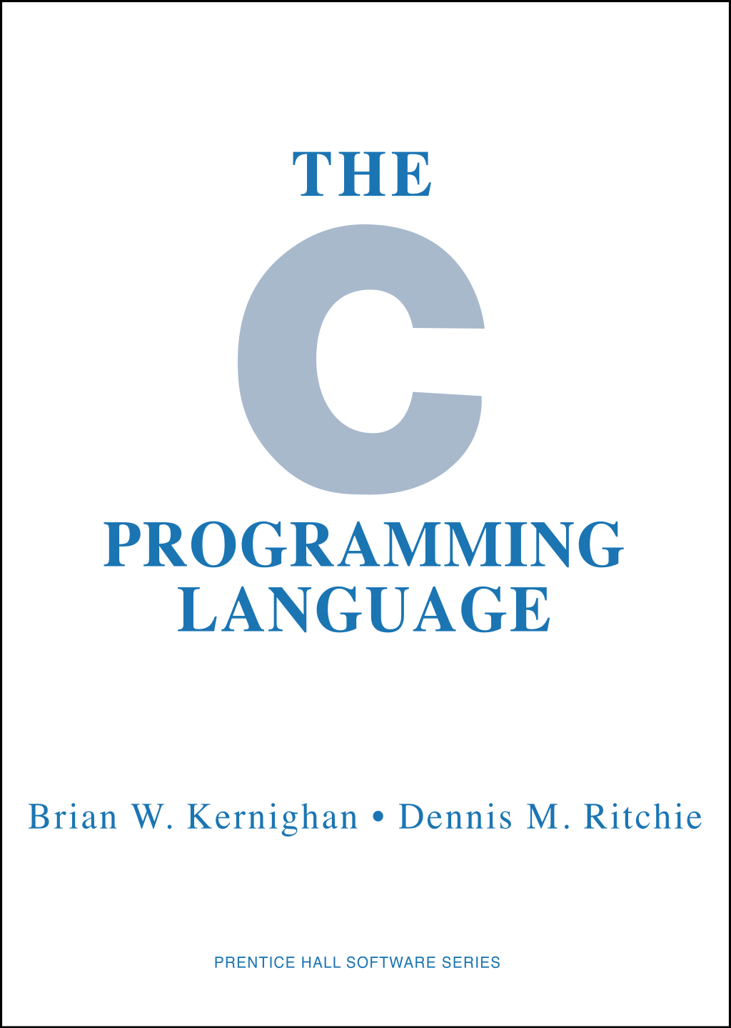
The C Mental Model
You can think of C programs as being along the lines of programs in the LMSM: a giant array of bytes in memory
Like on the LMSM, C programs have different segments of memory used for different things
Notes:
Can be found online… but I can’t link to it

Slide 4
The C Mental Model
The “code” segment (aka Text Segment) - the instructions of the program are stored here, typically read only
Corresponds to the low memory locations in the LMSM
Notes:
Can be found online… but I can’t link to it

Slide 5
The C Mental Model
The Data & BSS segments - global and static variables are stored here
Known, fixed size
BSS is zero initialized
Similar to the area just after a LMSM program where we stored constants
Notes:
Can be found online… but I can’t link to it

Slide 6
Memory Segments In C
C has different segments of memory
The Stack - where function parameters, local variables and other function related information is stored
The Heap - an area where dynamically allocated memory lives
Notes:
Can be found online… but I can’t link to it

Slide 7
Memory Segments In C
The Stack - where function parameters, local variables and other function related information is stored
Similar to the upper memory location in the LMSM, where the stack pointer register points to
Notes:
Can be found online… but I can’t link to it

Slide 8
Memory Segments In C
The Heap - an area where dynamically allocated memory lives
Similar to our use of the the higher 100s in the LMSM to store temporary runtime data
Notes:
Can be found online… but I can’t link to it

Slide 9
Memory Segments In C
These four segments of memory make up the core content of a C program
Memory in C is byte-addressed
If you have an address in a register it points to a given byte in memory
Notes:
Can be found online… but I can’t link to it

Slide 10
Memory Segments In C
Of the four memory segments, the two most important ones are The Stack and The Heap
The way each one of these is behaves is very different than the other, but C doesn’t make a major syntactic distinction between them
A big source of confusion!
Notes:
Can be found online… but I can’t link to it

Slide 11
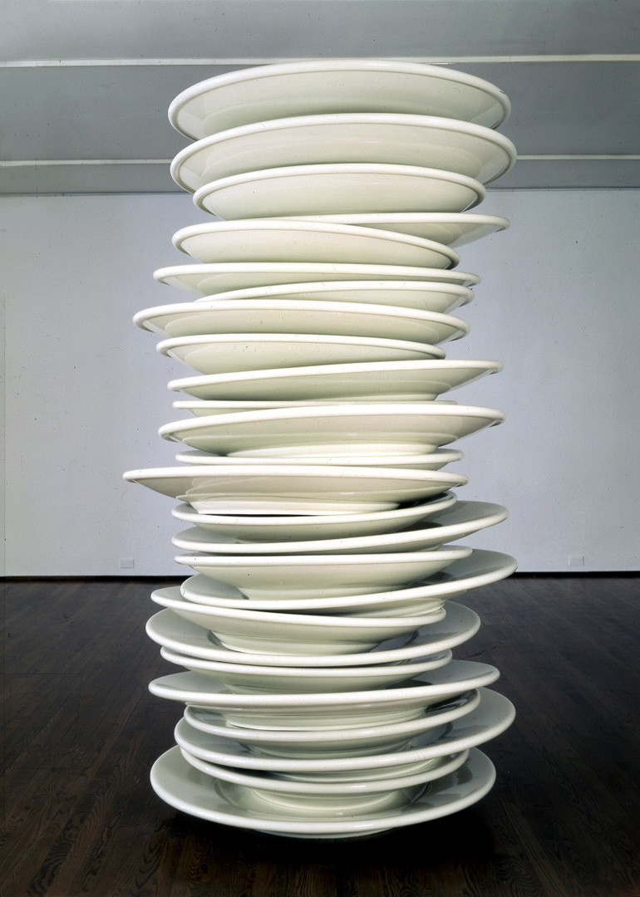
The Stack
Let’s first talk about the stack, since we’ve already been looking at it for function calls
Remember how the stack is used in function calls:
To store data that might be clobbered during function calls
To store return addresses
Notes:
Can be found online… but I can’t link to it

Slide 12
The Stack
Additionally, local variables and temporary variables in C tend to be stored on the stack
The stack is the natural place to store any data associated with a function call
Hence the term “The Stack Frame”: the area where a given function call stores its information
Notes:
Can be found online… but I can’t link to it

Slide 13
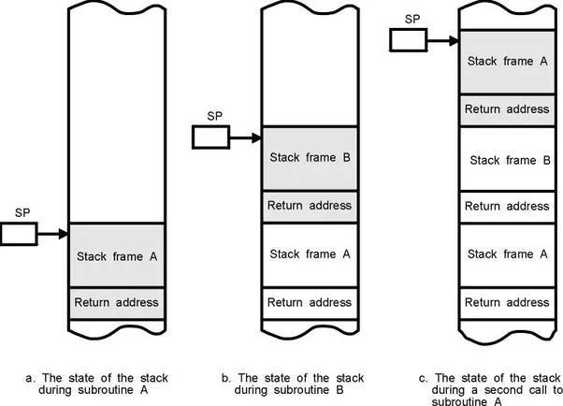
The Stack
In C, the stack is managed by the C runtime, rather than explicitly as in assembly
Remember, this is a big reason why C became so popular so quickly: it provided a good abstraction for function calls
Notes:
Can be found online… but I can’t link to it

Slide 14
The Stack
Remember when we saw the stack pointer being incremented and decremented in assembly?
This was establishing the “Stack Frame”, that is, the memory available on the stack for this particular function call
Notes:
Can be found online… but I can’t link to it

Slide 15
The Stack
When the function completes, the stack frame is deallocated and the CPU jumps back to the return location
Here “deallocated” just means: the stack pointer is incremented up and the data below it becomes “garbage”
Notes:
Can be found online… but I can’t link to it

Slide 16
The Stack
Note that memory for local variables is “automatically” reclaimed in C
A sort of garbage collection!
You don’t need to worry about allocating memory and deallocating memory for local variables in C, right?
The stack is why
Notes:
Can be found online… but I can’t link to it

Slide 17
The Stack
Note that although we tend to think of stacks growing up, in C (and in most programming environments) the stack tends to grow down
This is how it works on the LMSM too
Notes:
Can be found online… but I can’t link to it

Slide 18
The Stack
A recursive function demo will help demonstrate things
Notice that each function call has its own copies of the parameter i and the local variable i_address
What do you notice about i_address?
Notes:
Can be found online… but I can’t link to it

Slide 19
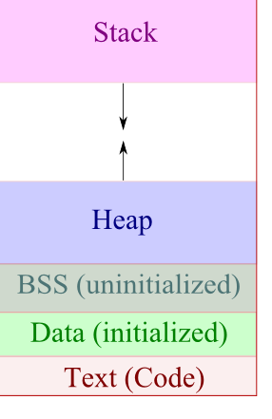
The Stack
The addresses are going down in value
Again, this is because in C on x86, the stack starts at a high number and grows downward
The debugger in CLion shows the more intuitive upward layout
Notes:
Can be found online… but I can’t link to it

Slide 20

The Stack
So, that’s The Stack, and it’s very cool, it even garbage collects itself!
If it’s so great, why don’t we only use the stack to store stuff?
Notes:
Can be found online… but I can’t link to it

Slide 21
The Stack
The stack *is* great and should be used for as much as possible, but the problem with the stack comes from the same places as its strength: it is tied to function invocations
What if data needs to live longer than a function invocation?
Notes:
Can be found online… but I can’t link to it

Slide 22
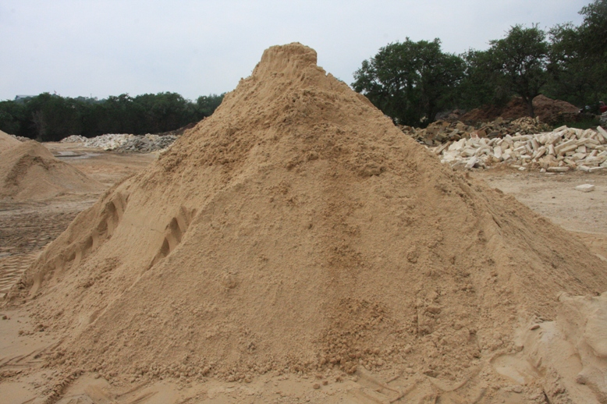
The Heap
Enter The Heap
The Heap is another section of memory that is not nearly as structured as the Stack
Notes:
Can be found online… but I can’t link to it

Slide 23
The Heap
You can think of the Heap as a huge pool of memory
You can take a handful of memory out whenever you’d like
But, and here’s the hard part, you had better put that memory back when you are done with it
Notes:
Can be found online… but I can’t link to it

Slide 24
The Heap
In C, working with the heap usually means using two functions:
malloc()
free()
Note that these functions are part of <stdlib.h> they are not part of the C programming language!
Notes:
Can be found online… but I can’t link to it

Slide 25
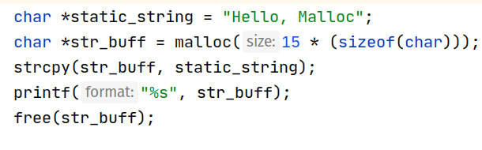
malloc()
Here is an example using malloc
We have a pointer to a string in the data segment
We allocate a 15 byte chunk of memory from the heap
We copy the string into it
We print it out
Finally, we free the memory
Notes:
Can be found online… but I can’t link to it

Slide 26
malloc()
Things to notice:
we had to pass in the amount of memory we wanted
What if we under-allocated?
The sizeof operator is commonly paired with malloc
Returns the number of bytes required by the given data type
Notes:
Can be found online… but I can’t link to it

Slide 27
malloc()
Since the argument to malloc() is a variable, the size of the allocated memory can be dynamic
E.g. based on user input
Note that the value returned by malloc is a pointer
We will talk about pointers in a sec
Notes:
Can be found online… but I can’t link to it

Slide 28
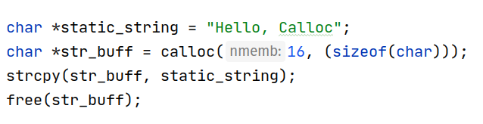
calloc()
Another thing to note is that malloc() makes no guarantees about the memory it handed back to you
E.g. It could have garbage data from previous usages
If you want data zeroed, you can use the calloc() function
Note that you pass two arguments to calloc
Worse is Better!
Notes:
Can be found online… but I can’t link to it

Slide 29
malloc()
Alternatively, if you wanted to achieve the same guarantee with malloc, you would need to use use the memset() function after you have allocated some memory.
Notes:
Can be found online… but I can’t link to it

Slide 30
free()
Data that you allocate on The Heap needs to be explicitly freed
Unlike the stack, there is no stack pointer to clean things up for you
If you don’t free your data properly, you will get memory leaks
Notes:
Can be found online… but I can’t link to it

Slide 31
free()
An additional danger is that if you free your data more than once, you will get double free error messages
In general, this means that when you allocate an object, you need to think about “who” owns the data
Who is going to free this?
Notes:
Can be found online… but I can’t link to it

Slide 32
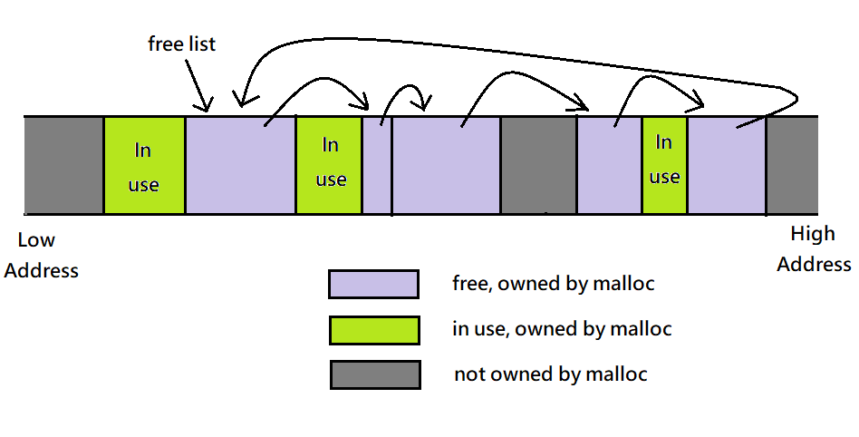
Behind The Scenes
Behind the scenes, a memory allocator is doing the work of finding memory chunks that satisfy your malloc() requests
This memory allocator (malloc, get it?) is keeping track of what chunks of memory it has handed out and which have been handed back
Notes:
Can be found online… but I can’t link to it

Slide 33
Behind The Scenes
Underneath it all is just a big chunk of memory “owned” by the memory allocator
Note that there isn’t any real enforcement of this, it’s just convention!
Notes:
Can be found online… but I can’t link to it

Slide 34
Behind The Scenes
This “big chunk of memory” is actually managed by the operating system
When the memory allocator needs to grow the heap for more memory, it calls the lower level brk() and sbrk() methods
Notes:
Can be found online… but I can’t link to it

Slide 35
Behind The Scenes
brk() and sbrk() directly manipulate the “program break value” which is the boundary of the heap
brk() sets the address to an explicit value
sbrk() increments it by a certain amount
Notes:
Can be found online… but I can’t link to it

Slide 36
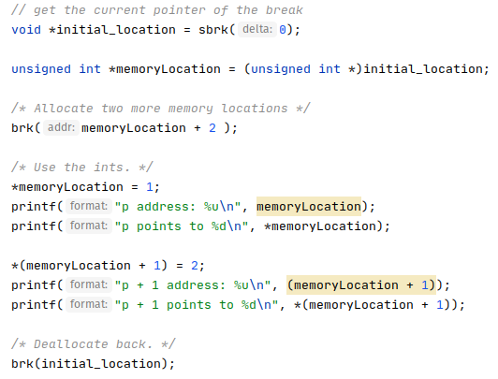
Malloc/Free
The allocator uses the system calls sbrk() and brk() to ask for more heap memory if necessary
Turns out that you can use the brk and sbrk to play directly with memory allocations if you’d like!
NB: this can really screw with malloc()!
Notes:
Can be found online… but I can’t link to it

Slide 37
Malloc/Free
The allocator uses the system calls sbrk() and brk() to ask for more heap memory if necessary
Turns out that you can use the brk and sbrk to play directly with memory allocations if you’d like!
NB: this can really screw with malloc()!
Notes:
Can be found online… but I can’t link to it

Slide 38
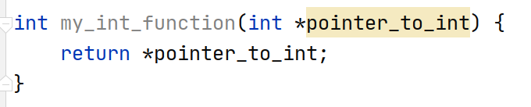
Pointers
A pointer is a variable that contains the memory address of something
Pointers are difficult for many beginners to understand because they aren’t close to the hardware
But we have pointers in the LMSM
The stack pointer!
Notes:
Can be found online… but I can’t link to it

Slide 39
Pointers
Pointers aren’t so bad as long as you have low level experience
In fact, for assembly programmers, they are obvious: how else would you refer to a big chunk of memory?
Notes:
Can be found online… but I can’t link to it

Slide 40
Pointers in C
C has good support for pointers, but, unfortunately, they made what I consider some bad syntactic choices
The * character is used to declare and also to derefrence pointers
Very confusing!
The function at right shows both uses of the * operator
Notes:
Can be found online… but I can’t link to it

Slide 41
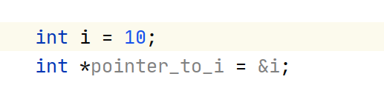
Pointers in C
Sometimes we want to go the other way: given a thing, get a pointer to that thing
For this we use the & operator
Note that we can get the address of anything
A stack-allocated variable
A heap-allocated variable
No difference!
Notes:
Can be found online… but I can’t link to it

Slide 42
Pointers in C
What are the advantages of pointers?
They are small (just an integer)
You can pass around a reference to a large chunk of data, rather than the data itself
You can do pointer arithmetic
They are what malloc() returns :)
Notes:
Can be found online… but I can’t link to it

Slide 43
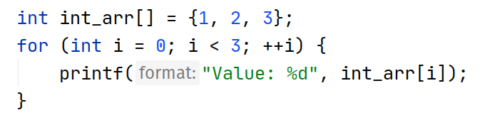
Arrays in C
Arrays are usually easier for people to understand in C
Arrays are usually stack-allocated in C
Familiar array-indexing syntax we are all used to
Note that arrays in C do not encode their length
You have to know how large an array is to iterate over it properly
Notes:
Can be found online… but I can’t link to it

Slide 44
Pointer/Array Correspondence
Pointers and arrays are deeply related to one another
This becomes apparent as you delve into pointer arithmetic
You can add to and subtract from pointers
This is known as “pointer arithmetic”
+ and - operations bump the address n “slots”
Notes:
Can be found online… but I can’t link to it

Slide 45
Pointer/Array Correspondence
In C, an array can be assigned to a pointer
The value of the pointer becomes the address of the first value in the array
However, pointers cannot be assigned to arrays
Nor can arrays be returned or passed into functions!
Notes:
Can be found online… but I can’t link to it

Slide 46
Pointer/Array Correspondence
These restrictions are part of the reason why pointers tend to be used so heavily in C: they are just more flexible and allowed in more situations, and you can always convert an array to them easily
Notes:
Can be found online… but I can’t link to it

Slide 47
Pointers
Note again that you can get a pointer to anything
This means it can be unclear what the lifetime of the underlying data being pointed to is
Languages like Rust try to make this more explicit by enforcing a single “owner” for the underlying data
Notes:
Can be found online… but I can’t link to it

Slide 48
Review
A C Program consists of different “segments” of memory
Of these segments, The Stack and The Heap are the most important
The Stack grows and shrinks automatically as functions are called
Memory allocated on the stack share the lifetime of the function
The Heap grows and shrinks based on calls to malloc() and free()
Memory allocated on the heap has no particular lifetime, it must be managed explicitly by the programmer
Pointers are just memory addresses “pointing” to actual data somewhere in memory
This data can be anywhere: the stack, the heap, the BSS, etc.

